Slide 1
Data Characteristics
Saryu Onishi
HES 3000-002, Sport Performance Analytics

Slide 2
Understanding the Dataset

Slide 3
Start With the Dataset, Not the Numbers
What is being measured?
When and where were the data collected?
What does one row represent?
What does each column represent?
Notes:
We already did the first two

Slide 4
What Does One Row Represent?
One row could represent:
One athlete
One athlete during one season
One athlete during one game
One shot, pass, or possession
One sensor measurement
The meaning of a row is the dataset’s unit of observation.

Slide 5
The Same Sport, Different Units of Observation
Dataset | One row represents
Roster | One athlete
Season statistics | One athlete-season
Box score | One athlete-game
Shot chart | One shot attempt
Training load | One athlete-session
10 Hz GPS data | One athlete at 1/10th of a second

Slide 6
Data Granularity
Granularity describes the level of detail in a dataset.
Season totals provide a broad summary.
Game-level data show changes across games.
Event-level data describe individual actions.
Sensor data may contain several measurements per second.
More detailed data provide more possibilities, but also require more storage, cleaning, and interpretation.

Slide 7
What Identifies Each Observation?
An identifier distinguishes one observation from another.
Examples:
  athlete_id
  game_id
  date
  trial_number
An athlete’s name may not be a reliable identifier:
Names may be misspelled.
Two athletes may share the same name.

Slide 8
Variables and Data Formats

Slide 9
Qualitative and Quantitative Data
Categorical variables
Describe groups, labels, or states.
  Position
  Team
  Play type
  Availability status
Numerical variables
Represent counts or measurements.
  Minutes played
  Jump height
  Distance traveled
  Number of shots

Slide 10
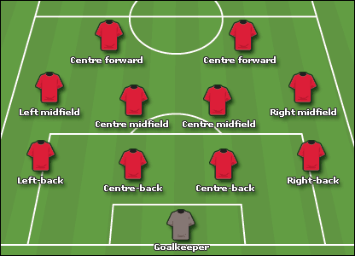

Categories
Nominal
Categories without an inherent order:
  Position
  Team
  Shot outcome
  Injury type
Ordinal
Categories with a meaningful order:
  Low, moderate, high
  First, second, third
  Availability classifications
  Subjective rating scales

Slide 11

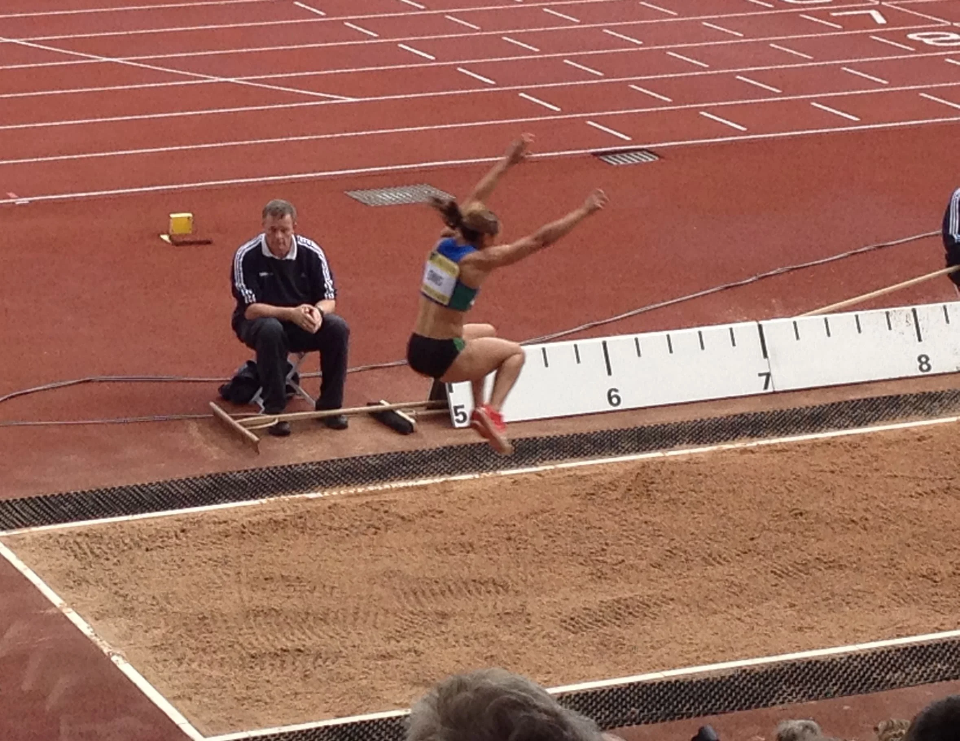
Counts and Measurements
Discrete data
Usually represent counts:
  Rebounds
  Goals
  Sprint efforts
  Shot attempts
Continuous data
Usually represent measurements:
  Speed
  Distance
  Time
  Force
  Jump height

Slide 12
Dates and Times
Dates and times may represent:
Competition date
Collection date
Session start time
Common problems include:
09/10/26 versus 10/09/26
Dates stored as text
Inconsistent time zones
Notes:
Tz or utc as solution

Slide 13
Units and Definitions
A number has little meaning without a definition and unit.
The unit can completely change what is being measured
  Is speed measured in mph, km/h, or m/s?
  Is body mass recorded in pounds or kilograms?
  Is duration recorded in seconds or minutes?

Slide 14
Data Dictionary
A data dictionary explains the variables in a dataset.
Variable | Meaning | Unit or values
athlete_id | Unique athlete identifier | Text
duration | Time spent participating | Minutes
distance | Total tracked distance | Meters
session_rpe | Athlete-reported exertion | 1–10
player_load | Total tracked workload | AU

Slide 15
Data Structure

Slide 16
Wide and Long Data
Wide format
Multiple measurements appear in separate columns.
Athlete | Week_1 | Week_2 | Week_3
Long format
Each measurement appears in a separate row.
Athlete | Week | Jump_Height
Wide vs Long :
Wide data are often easier to read in a spreadsheet.
Long data are usually easier to group, visualize, and analyze.

Slide 17
Wide vs Long?
Which would be better for:
  Plotting jump height across ten weeks
  Comparing the most recent test for every athlete
  Entering scores for a small number of assessments
  Adding new testing dates throughout a season
  → Long
  → Either
  → Wide may be convenient
  → Long

Slide 18
Raw Data and Summary Data
Raw data
Individual events or measurements
Greater detail
More opportunities for checking and reanalysis
Eg: every jump trial
Summary data
Totals, averages, or maximums
Easier to interpret quickly
May hide variation or unusual observations
Eg: each athlete’s average or maximum jump height
Notes:
Other example : pbp data vs box score

Slide 19
One Dataset, Multiple Tables?
Sport data may be stored across several related tables:
  Athlete information
  Games or training sessions
  Performance test results
Trying to place everything in one spreadsheet can produce:
  Repeated athlete information
  Inconsistent values
  Excessively wide datasets
  Confusion about what each row represents

Slide 20
Common File Formats
CSV
  Plain-text table
  Easy to import into most software
  Does not preserve formatting, formulas, or multiple sheets
Excel
  Supports multiple sheets, formulas, and formatting
  Convenient for manual data entry
  Makes it easier to create structures that look good but analyze poorly

Slide 21
Common Problems

Slide 22
Spreadsheet Designed for People
A spreadsheet may be readable to a person but difficult to analyze.
Common examples:
  Merged cells
  Multiple header rows
  Blank rows separating groups
  Totals mixed with individual observations
Statistical software cannot interpret meaning that exists through visual formatting.

Slide 23
One Column, One Type of Information
Problematic cells might contain:
  185 lb
  Injured - ankle
  DNP
  Smith, John #24
These combine values, units, notes, or identifiers.
One column should have one consistent meaning
name | jersey_number | weight_lbs | status | injury_location
John Smith | 24 | 185 | Injured | ankle

Slide 24
Inconsistent Categories
The same category might appear as:
  Guard
  guard
  G
  G (with an extra space)
  Point Guard
To a person, these may appear equivalent but to software, they are different categories.
Categories need consistent spelling, capitalization, and definitions.

Slide 25
Other common data problems
Duplicate observations: truly identical or represent separate events?
Impossible and suspicious values
Missing data: truly missing or something else?

Slide 26
Data Hygiene

Slide 27
Basic Data Hygiene
Data hygiene means keeping data organized, consistent, and understandable.
Before analysis:
  Preserve the original file.
  Create a separate working copy (in excel, copy sheet).
  Identify the meaning of each row and column. (data dictionary)
  Standardize categories, formats, and units.
  Check duplicates, ranges, and missing values.
  Document important changes.

Slide 28
Summary & Looking Ahead
Understand the dataset before calculating anything.
Structure determines what questions the data can answer.
Values require definitions, units, and context.
Missing values can represent different situations.
Data inspection should occur before analysis.
Next: data visualization

